Slide 1
Introduction into Javascript

Slide 2
JavaScript brings a dynamic functionality to your websites.
Every time you see something pop up when you mouse over an item in the browser, or see new text, colors, or images appear on the page in front of your eyes, or grab an object on the page and drag it to a new location -- all those things are done through JavaScript.
Javascript is different with Java programming. However, the naming was just a marketing ploy at those time to help the new scripting language benefit from the popularity of the Java programming language.
JavaScript gained new power when the HTML elements of the web page got a more formal, structured definition in what is called the Document Object Model, or DOM.

Slide 3
JavaScript is a client-side scripting language that runs entirely inside the web browser.
To call it up, you place it between opening <script> and closing </script> HTML tags.
Scripts can be placed in the <body>, or in the <head> section of an HTML page, or in both.

Slide 4
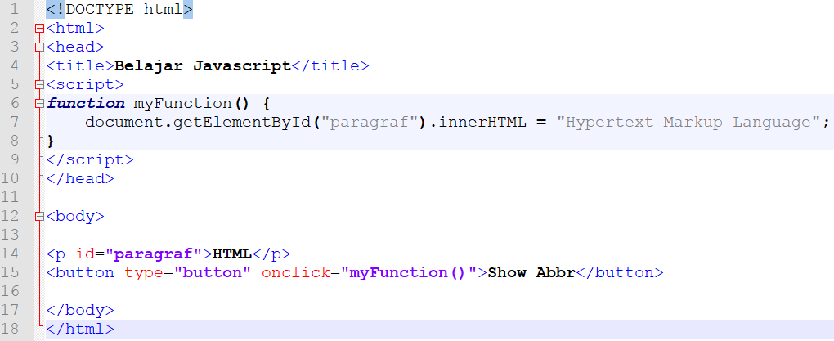
Internal JavaScript inside <head>

Slide 5
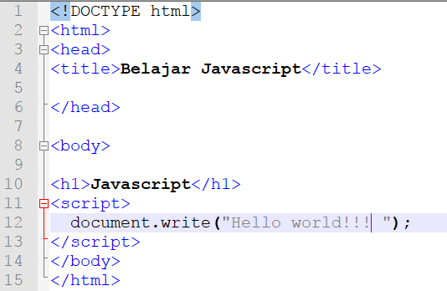
Internal JavaScript inside <body>

Slide 6
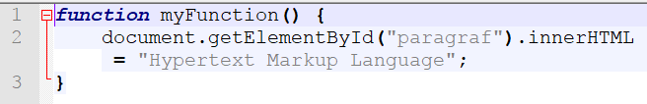
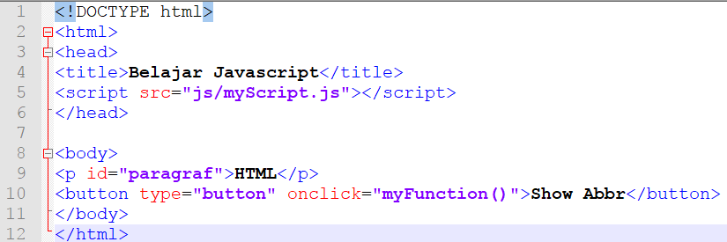
External JavaScript

Slide 7
External JavaScript Advantages
It separates HTML and code
It makes HTML and JavaScript easier to read and maintain
Cached JavaScript files can speed up page loads

Slide 8
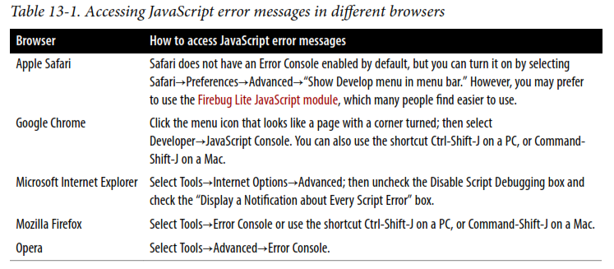
Debugging Javacript Error
Javascript doesn't display error messages in the browser.
JavaScript handles error messages in a way that changes according to the browser used.

Slide 9


Using Comments
Single line comment
Multiline comment

Slide 10

Semicolons
Unlike PHP, JavaScript generally does not require semicolons if you have only one statement on a line.
However, when you wish to place more than one statement on a line, you must separate them with semicolons

Slide 11
JavaScript Variables
JavaScript variables are containers for storing data values.
All JavaScript variables must be identified with unique names.
These unique names are called identifiers.
The general rules for constructing names for variables (unique identifiers) are:
Names can contain letters, digits, underscores, and dollar signs.
Names must begin with a letter
Names can also begin with $ and _ (but we will not use it in this tutorial)
Names are case sensitive (y and Y are different variables)
Reserved words (like JavaScript keywords) cannot be used as names

Slide 12
JavaScript Variables (cont.)
A JavaScript variable is declared with the var keyword:
var x;
A variable declared without a value will have the value undefined.
The variable x will have the value undefined because variable x is declared without a value.
After the declaration, the variable has no value. (Technically it has the value of undefined). To assign a value to the variable, use the equal sign:
x = 5;
You can declare many variables in one statement. Start the statement with var and separate the variables by comma:
var x = 5, y=6, z=9;

Slide 13
JavaScript Variables (cont.)
If you re-declare a JavaScript variable, it will not lose its value.
The variable x will still have the value 5 after the execution of these statements:
var x = 5;
var x;

Slide 14



String Variables (cont.)
JavaScript string variables should be enclosed in either single or double quotation marks.
You may include a single quote within a double-quoted string or a double quote within a single-quoted string.
But you must escape a quote of the same type by using the backslash character.
To read from a string variable, you can assign it to another one.
You can use it in a function.

Slide 15

Numeric Variable
Creating a numeric variable is as simple as assigning a value, like these examples:
Like strings, numeric variables can be read from and used in expressions and functions.

Slide 16
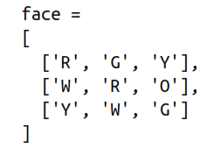
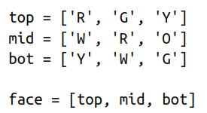

Array
To assign values to an array, use the following syntax (which in this case creates an array of strings):
To create a multidimensional array, nest smaller arrays within a larger one.
To access the element two down and three along in this matrix, you would use the following (because array elements start at position 0):

Slide 17
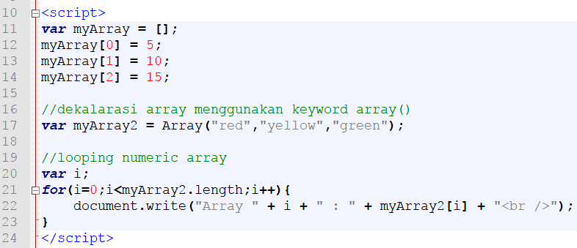
Array (cont.)
Numeric Array

Slide 18
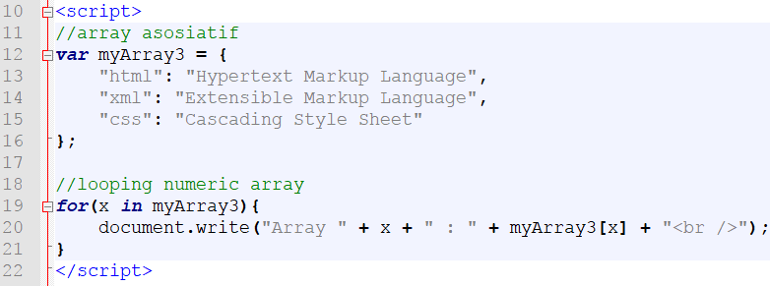
Array (cont.)
Associative Array

Slide 19
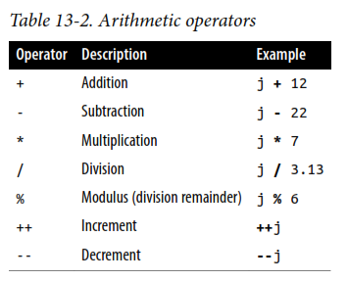
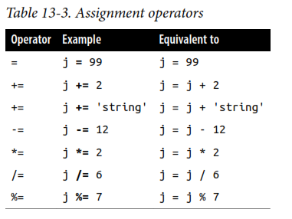
JavaScript Operators

Slide 20
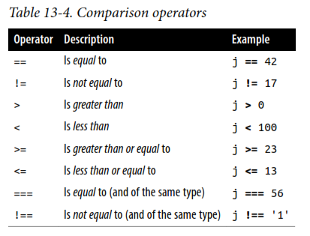
JavaScript Operators (cont.)

Slide 21
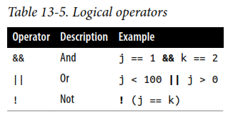
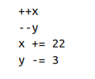

JavaScript Operators (cont.)
Variable incrementing and decrementing
String concatenation

Slide 22
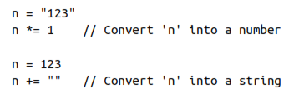
Variable Typing
JavaScript is a very loosely typed language.
The type of a variable is determined only when a value is assigned and can change as the variable appears in different contexts.
Usually, you don’t have to worry about the type; JavaScript figures outwhat you want and just does it.

Slide 23
JavaScript Function
A JavaScript function is defined with the function keyword, followed by a name, followed by parentheses ().
Function names can contain letters, digits, underscores, and dollar signs (same rules as variables).
The parentheses may include parameter names separated by commas: (parameter1, parameter2, ...)
The code to be executed, by the function, is placed inside curly brackets: {}

Slide 24
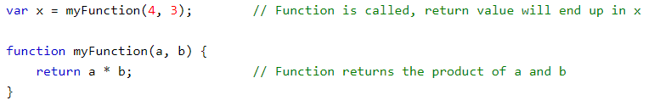
JavaScript Function (cont.)
Function parameters are the names listed in the function definition.
Function arguments are the real values received by the function when it is invoked.
Inside the function, the arguments (the parameters) behave as local variables.

Slide 25
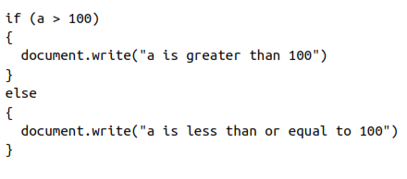
Conditionals: If-Else Statement

Slide 26
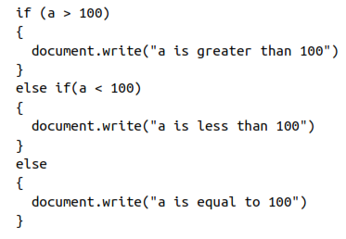
Conditionals: If-Else Statement

Slide 27
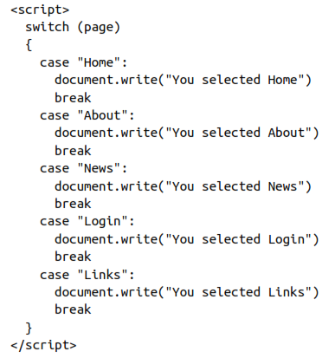
Conditionals: Switch Statement

Slide 28
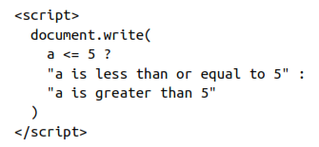

Conditionals: The ? Operator

Slide 29
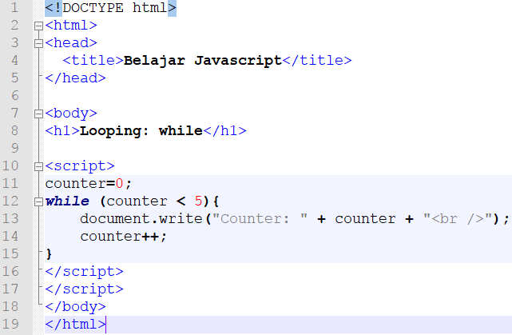
Looping: while loops

Slide 30
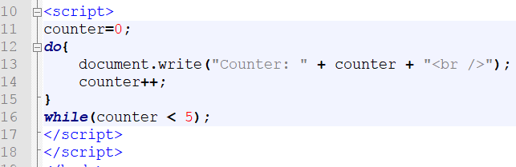
Looping: do-while loops

Slide 31
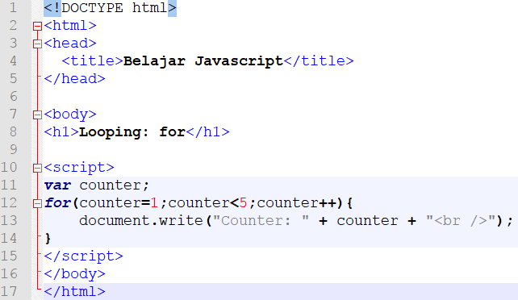
Looping: for loops

Slide 32
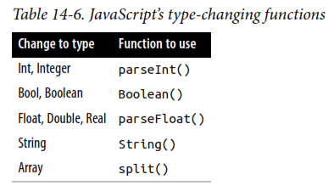

Explisit Casting

Slide 33

JavaScript HTML DOM
When a web page is loaded, the browser creates a Document Object Model of the page.
The HTML DOM model is constructed as a tree of Objects:

Slide 34
The HTML DOM is a standard object model and programming interface for HTML. It defines:
The HTML elements as objects
The properties of all HTML elements
The methods to access all HTML elements
The events for all HTML elements
In other words: The HTML DOM is a standard for how to get, change, add, or delete HTML elements.

Slide 35
The DOM Programming Interface
The HTML DOM can be accessed with JavaScript (and with other programming languages).
In the DOM, all HTML elements are defined as objects.
The programming interface is the properties and methods of each object.
A property is a value that you can get or set (like changing the content of an HTML element).
A method is an action you can do (like add or deleting an HTML element).
In the example below, getElementById is a method, while innerHTML is a property.

Slide 36
DOM - Finding HTML Elements
The document object represents your web page.
If you want to access any element in an HTML page, you always start with accessing the document object.
Finding HTML Elements
Method | Description
document.getElementById(id) | Find an element by element id
document.getElementsByTagName(name) | Find elements by tag name
document.getElementsByClassName(name) | Find elements by class name

Slide 37
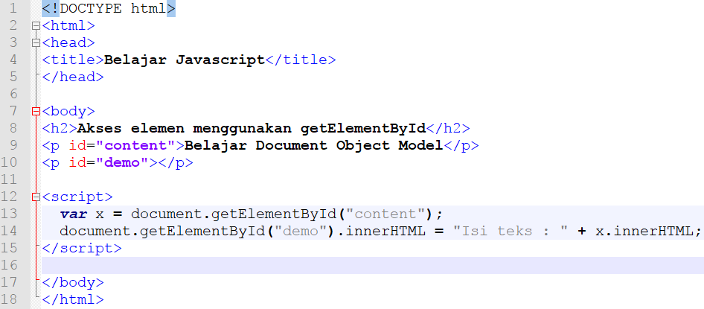
DOM - Finding HTML Elements (cont.)

Slide 38
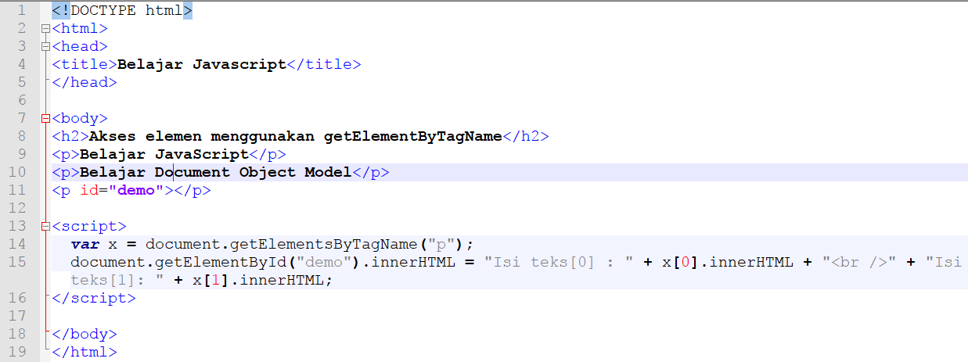
DOM - Finding HTML Elements (cont.)

Slide 39
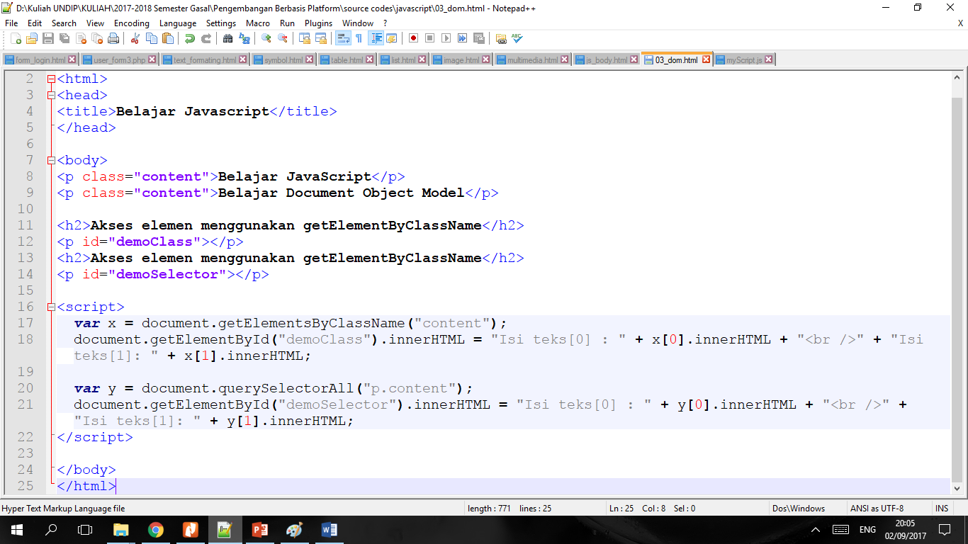
DOM - Finding HTML Elements (cont.)

Slide 40
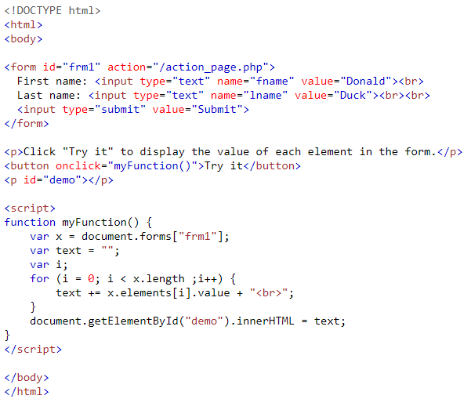
Finding HTML Elements by HTML Object Collections

Slide 41
DOM - Changing HTML Elements
Method | Description
element.innerHTML = new html content | Change the inner HTML of an element
element.attribute = new value | Change the attribute value of an HTML element
element.setAttribute(attribute, value) | Change the attribute value of an HTML element
element.style.property = new style | Change the style of an HTML element

Slide 42
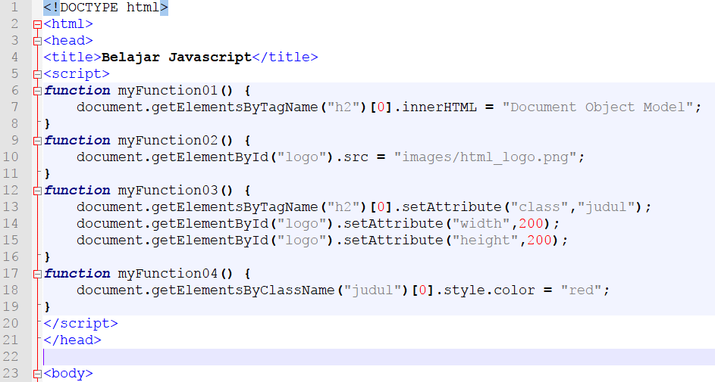
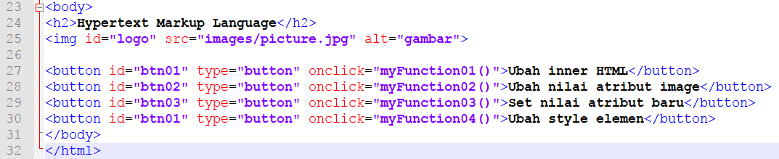

Slide 43
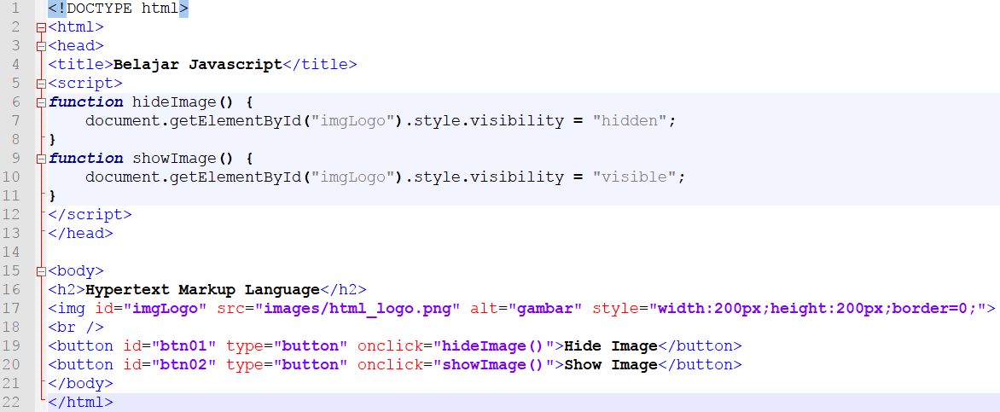
DOM - Changing HTML Elements (cont.)
Changing visibility of HTML element

Slide 44
DOM - Adding and Deleting Elements
Method | Description
document.createElement(element) | Create an HTML element
document.removeChild(element) | Remove an HTML element
document.appendChild(element) | Add an HTML element
document.replaceChild(element) | Replace an HTML element
document.write(text) | Write into the HTML output stream

Slide 45
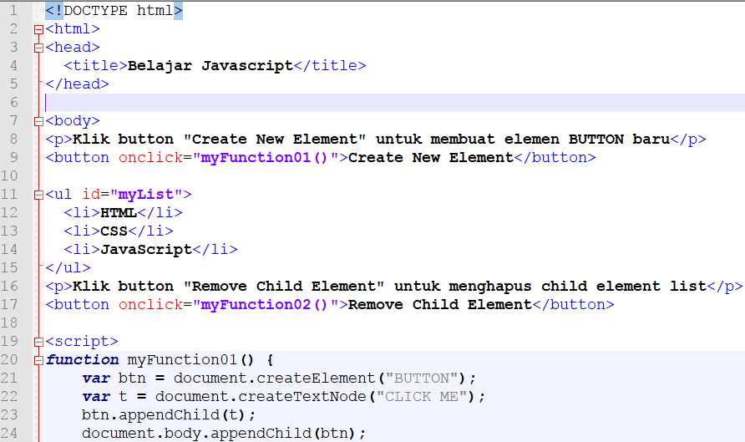
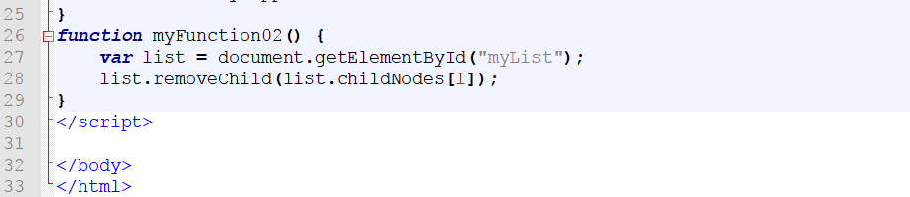

Slide 46
DOM - Adding Events Handlers
Method | Description
document.getElementById(id).onclick = function(){code} | Adding event handler code to an onclick event

Slide 47
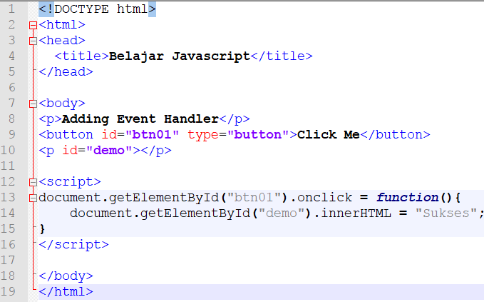
DOM - Adding Events Handlers (cont.)

Slide 48
DOM - Event
A JavaScript can be executed when an event occurs, like when a user clicks on an HTML element.
Examples of HTML events:
When a user clicks the mouse
When a web page has loaded
When an image has been loaded
When the mouse moves over an element
When an input field is changed
When an HTML form is submitted
When a user strokes a key

Slide 49
DOM – Event (cont.)
Event | Description
onchange | An HTML element has been changed
onclick | The user clicks an HTML element
onmouseover | The user moves the mouse over an HTML element
onmouseout | The user moves the mouse away from an HTML element
onkeydown | The user pushes a keyboard key
onload | The browser has finished loading the page

Slide 50
In this example, the content of the <h1> element is changed when a user clicks on it:
<!DOCTYPE html> <html> <body> <h1 onclick="this.innerHTML = 'Ooops!'">Click on this text!</h1> </body> </html>

Slide 51
In this example, a function is called from the event handler:
<!DOCTYPE html> <html> <body> <h1 onclick="changeText(this)">Click on this text!</h1> <script> function changeText(id) { id.innerHTML = "Ooops!"; } </script> </body> </html>

Slide 52
To assign events to HTML elements you can use event attributes.
<button onclick="displayDate()">Try it</button>
The HTML DOM allows you to assign events to HTML elements using JavaScript:
<script> document.getElementById("myBtn").onclick = displayDate; </script>

Slide 53
DOM Navigation
According to the W3C HTML DOM standard, everything in an HTML document is a node:
The entire document is a document node
Every HTML element is an element node
The text inside HTML elements are text nodes
Every HTML attribute is an attribute node (deprecated)
All comments are comment nodes

Slide 54
Node Realtionship
The nodes in the node tree have a hierarchical relationship to each other.
The terms parent, child, and sibling are used to describe the relationships.
In a node tree, the top node is called the root (or root node)
Every node has exactly one parent, except the root (which has no parent)
A node can have a number of children
Siblings (brothers or sisters) are nodes with the same parent

Slide 55
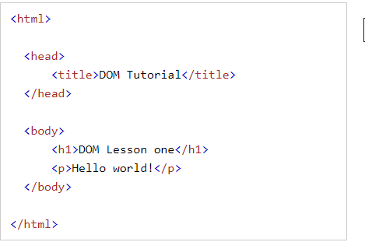
<html> is the root node
<html> has no parents
<html> is the parent of <head> and <body>
<head> is the first child of <html>
<body> is the last child of <html>
<head> has one child: <title>
<title> has one child (a text node): "DOM Tutorial"
<body> has two children: <h1> and <p>
<h1> has one child: "DOM Lesson one"
<p> has one child: "Hello world!"
<h1> and <p> are siblings

Slide 56
Navigating Between Nodes
You can use the following node properties to navigate between nodes with JavaScript:
parentNode
childNodes[nodenumber]
firstChild
lastChild
nextSibling
previousSibling

Slide 58
Form Validation
Data validation is the process of ensuring that user input is clean, correct, and useful.
Typical validation tasks are:
has the user filled in all required fields?
has the user entered a valid date?
has the user entered text in a numeric field?
Most often, the purpose of data validation is to ensure correct user input.
Validation can be defined by many different methods, and deployed in many different ways.
Server side validation is performed by a web server, after input has been sent to the server.
Client side validation is performed by a web browser, before input is sent to a web server.

